Slide 1
Thermometer Project
By Thomas O’Mahony, 20103278

Slide 2
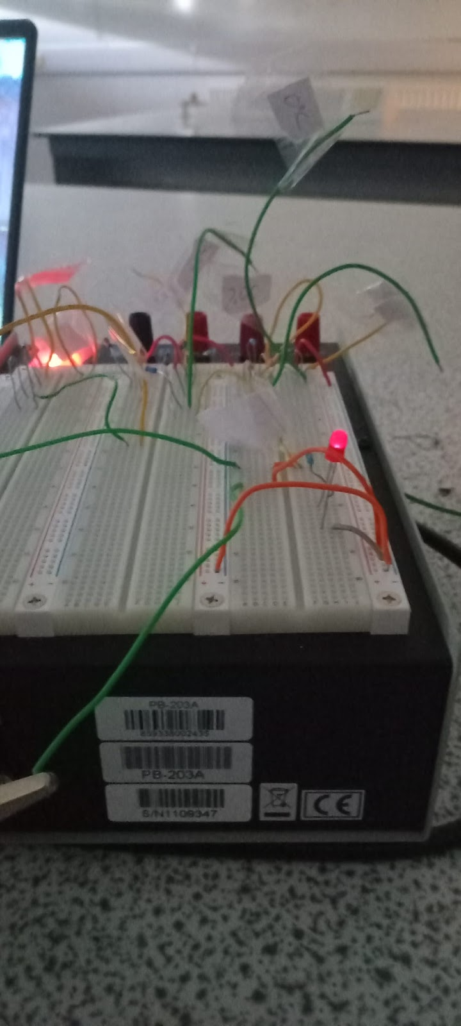
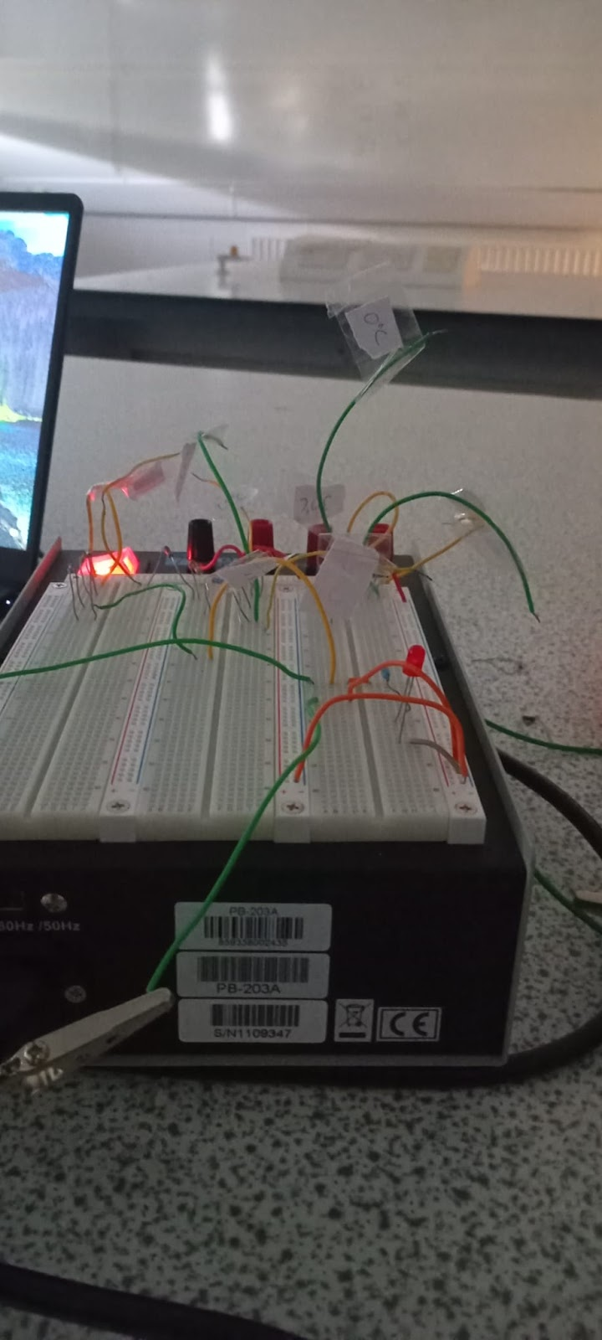
Results of the Experiment
The results of the experiment is that the LED will turn off if the thermistor temperature is above the temperature we are checking for.
Image 7 + 8, Testing at 25°C (LED on) and 20°C (LED off) in a room at 21°C to 23°C

Slide 3
Analyse the results
Our results show us that if we know the resistance of the thermistor at a given temperature, we can configure the circuit to find the temperature of the thermistor.
However, the results will start to get inaccurate after a certain temperature as the difference in resistance will become negligible.

Slide 4
Discussion
We configure how big or small the circuit is as well as detecting within or above a certain temperature.
A problem that can occur is that the LED will dimly light up even when the temperature of the thermistor is too low.

Slide 5
Discussion
improvements can be made to the circuit, the most notable being to use a linearly scaling thermistor.
This will allow for more accurate and consistent readings especially at the higher temperatures as the resistance change between higher temperatures fall as low as 0.9Ω.

Slide 6
Conclusion
It is possible to accurately find the temperature, within a certain range, of a thermistor if the resistance at that temperature is known.
It is possible to display it in a circuit using LEDs by using Ohms law and resistors.

